Slide 1


SOCIAL BUZZ ANALYSIS

Slide 2


Today's agenda
Project recap
Problem
The Analytics team
Process
Insights
Summary

Slide 3

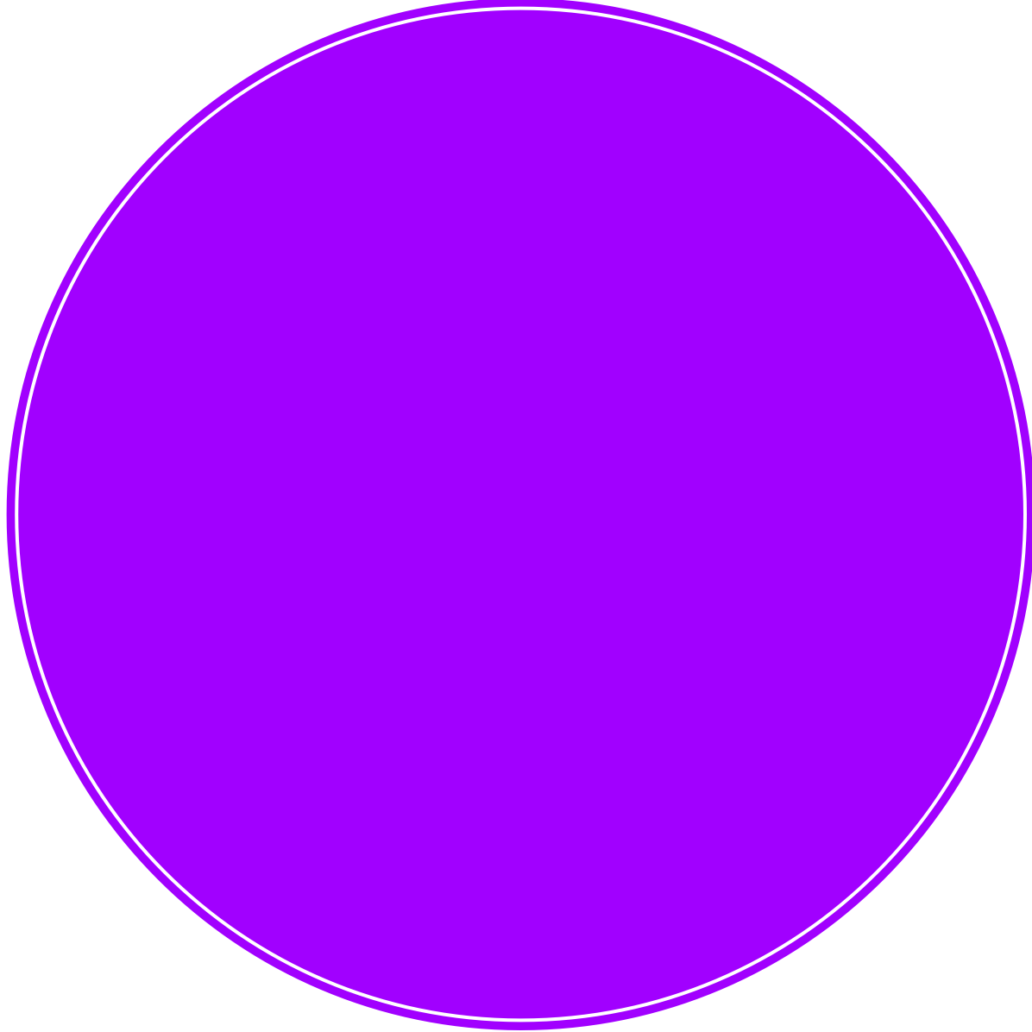
The engagement with Social Buzz is a three-month initial project aimed at demonstrating our capabilities as the best advisory firm to support their growth and prepare for an IPO.
Project Objectives
An audit of Social Buzz big data practice
Recommendations for a successful IPO
An analysis of their content categories that highlights the top 5 categories with the largest aggregate popularity.
Project Recap

Slide 4
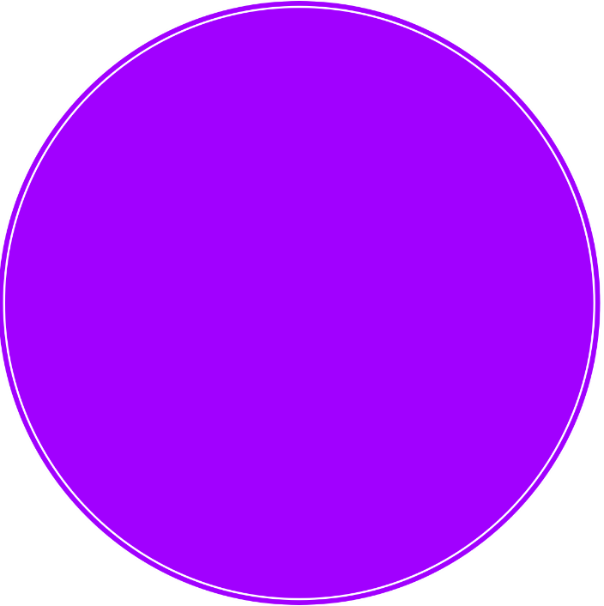
Analysis to find Social Buzz top 5 most popular categories of content.
How many unique categories are there?
How many reactions are there to the most popular category?
What was the month with the most posts?
What was the day with most posts?
Problem

Slide 5




Andrew Fleming
(Chief Technical Architect)
The Analytics team
Marcus Rompton
(Senior Principle)
Mariam Morenikeji.W
(Data Analyst)

Slide 6

Process
1
Data Understanding
2
Data Cleaning
3
Data Modelling
4
Data Analysis
5
Uncover Insights

Slide 7
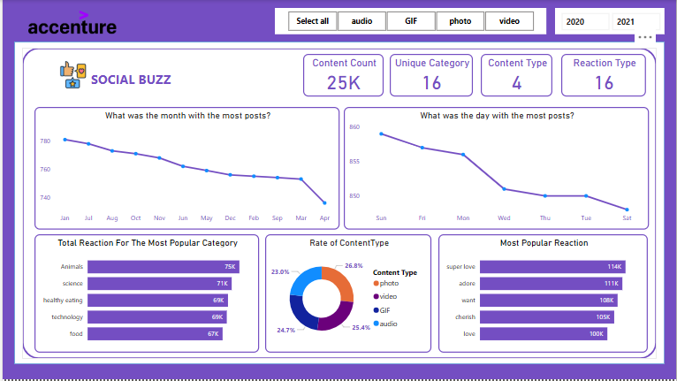

Insights

Slide 8
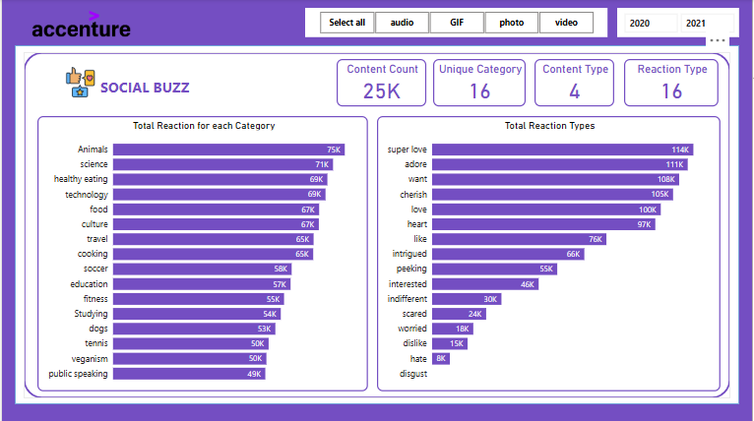

Slide 9
INSIGHTS
There are a total of 25,000 posts.
There are 16 unique categories, 4 content types, and 16 reaction types.
January has the highest number of posts, followed by July, August, October, while April has the least posts.
The total reactions for the five most popular categories are Animals, Science, Healthy Eating, Technology, and Food.
There are 4 content types: Photo, Video, GIF, and Audio, with distribution rates of 26.8%, 25.4%, 24.7%, and 23.0%, respectively.
The most popular reactions out of the 16 available reactions are "Super Love," "Adore," "Want," "Cherish," and "Love."
Sunday is the day with the most posts, followed by Friday, Monday, Wednesday, Thursday, Tuesday, and Saturday, which has the least.

Slide 10

Recommendations
Focus on Popular Categories: Prioritize content in Animals, Science, Healthy Eating, Technology, and Food to maximize engagement.
Leverage Content Types: Create more photos and videos (26.8% and 25.4% engagement) while experimenting with GIFs and audio for variety.
Boost Engagement with Reactions: Craft emotionally appealing posts to encourage reactions like "Super Love," "Adore," and "Love."
Optimize Posting Times: Post more on Sundays and Fridays, and consider running campaigns in April to boost engagement.
Run Seasonal Campaigns: Take advantage of high engagement in January and explore tech trends for technology-focused posts.
By aligning content with these insights, you can increase interaction and drive better results.
Summary

Slide 11
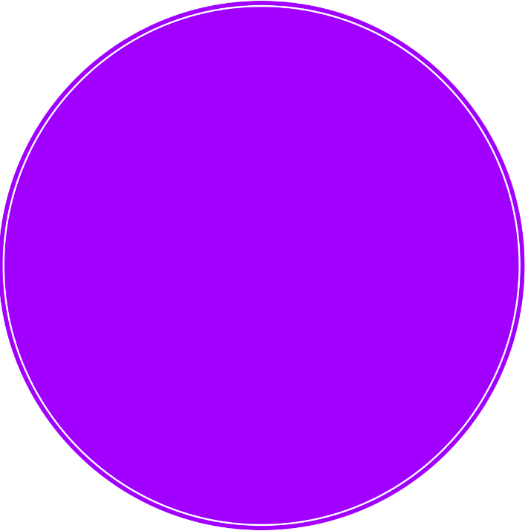
Thank you!
ANY QUESTIONS?

